Slide 1
Unleash student creativity with app smashing!
Laura CHaffey
iMotion HD
iMovie
Tellagami
BuddyPoke
Dpink Green Screen
Hello Oil Painter
Superimpose
Strip Designer
Yakit Kids
ChatterPix Kids

Slide 2
What is app smashing?
Create content with one app.
Create content in another app.
Merge the content together (smash it)
Publish content to the web.
Greg Kulowiec (ETT 2013)

Slide 3
Project 1: Narrate a stop motion animation

Slide 5
Work flow

Slide 6
How can we apply it?
Explain a scientific concept e.g. water cycle, photosynthesis.
Create a procedural text e.g. how to make paper aeroplanes.
Narrate a flow chart.
Recreate a scene from a picture book.
Create an advertisement e.g. Skittles

Slide 7
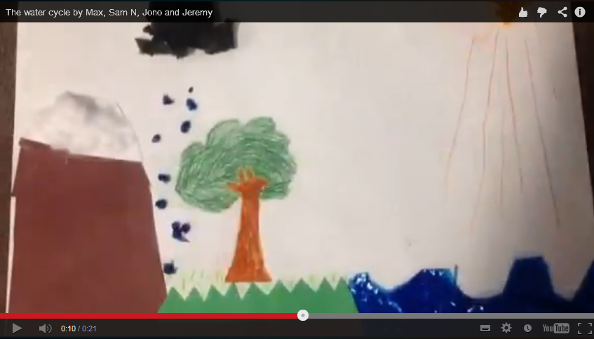
Create a stop motion animation using iMotion HD
Export to camera roll.
Import into iMovie.
Add narration.
Export to camera roll
for sharing.

Slide 8
Project 2: video Narration using green screen technology

Slide 11
Work flow
Background
OR
OR
Foreground

Slide 12
Create a background video by either video recording a scene or creating one using iMotion HD. Export to camera roll.
Create a foreground video using Tellagami or BuddyPoke using the green screen background option. Export to camera roll.
Open Doink Green Screen app.
Import foreground video first then background video.
Crop, edit sound and check chroma key.
Save and export to camera roll for sharing.

Slide 13
Project 3: Create a comic strip

Slide 14
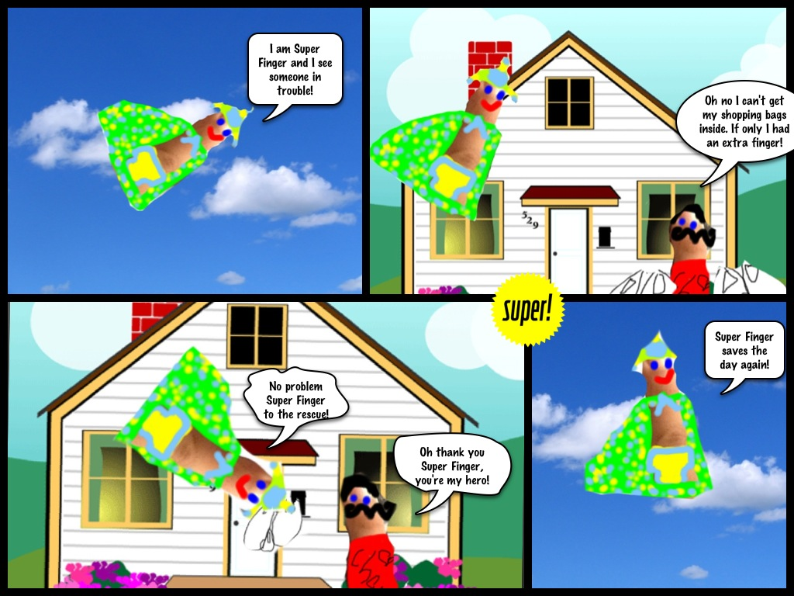
Text innovation
After reading superfinger in 13th story treehouse create your own superfinger comic

Slide 15
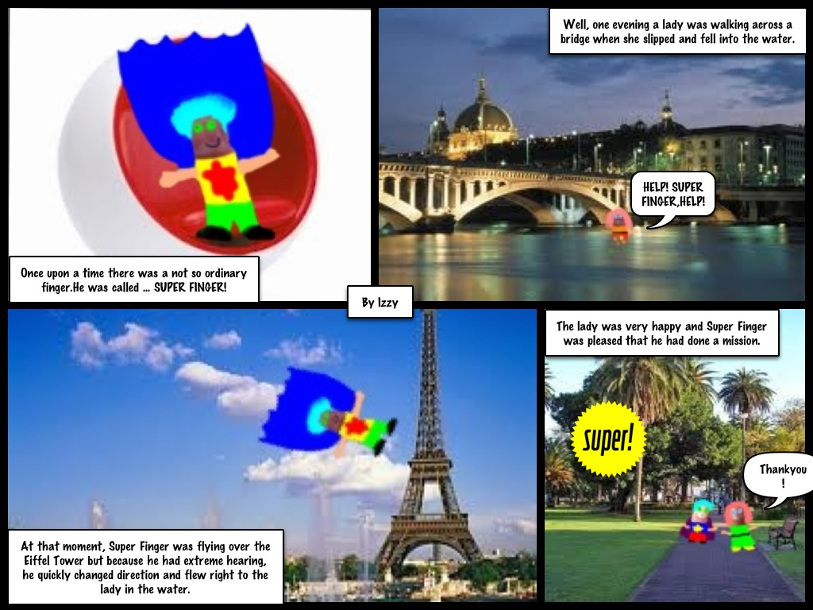

Slide 16
Work flow

Slide 17
1. Take a photo of your finger.
2. Open Hello Oil Painter (or other drawing app)
3. Import your photo into Oil Painter and dress it up to
look like a super hero.
4. Save to photo roll.
5. Open Safari to locate a suitable background image
OR create your own background image in a drawing
app OR take a photo for your background!
6. Save to photo roll.
Open Superimpose. Add background, then foreground,
apply mask then transform to arrange. Merge and export.
Open Strip Designer. Import image into frame. Add speech bubbles.
Repeat process for other frames!

Slide 18
Project 4: Create a comic video

Slide 20
Work flow

Slide 21
1. Open either ChatterPix Kids or Yakit Kids.
2. Import previously created image.
3. Add narration to the image to create a video.
4. Save to photo roll.
5. Repeat for each scene.
6. Open iMovie.
Import each video,
Add titles, audio and transitions.
Save completed project to photo roll for sharing!

Slide 22
http://ictwithmisssc.weebly.com

