Slide 1
DIGiTAL AND MULTiMODAL TEXTS
in the primary classroom

Slide 2
experiment with basic visual, multimodal and digital processes to represent some simple ideas expressed in texts and to convey experiences
understand that imaginative texts can be composed for a range of audiences and purposes, using a range of media
respond to texts that depict aspects of home and community life, eg short films and digital texts ICT
understand concepts about print and screen, including how books, film and simple digital texts work, and know some features of print, for example directionality
respond to literature and a variety of other texts from a range of storytellers and cultures, using picture books and online sources
respond to a range of imaginative and creative texts, including visual media
communicate the purposes of drawings and other visual media
compose texts using drawings and other visual media to create meaning
select simple print, visual and/or digital texts to read independently for enjoyment and pleasure
use imagination to represent aspects of an experience using written text, drawings and other visual media
use visual, multimodal and digital processes to represent simple aspects of home and community life
recognise parts of print and digital texts
ES1

Slide 3
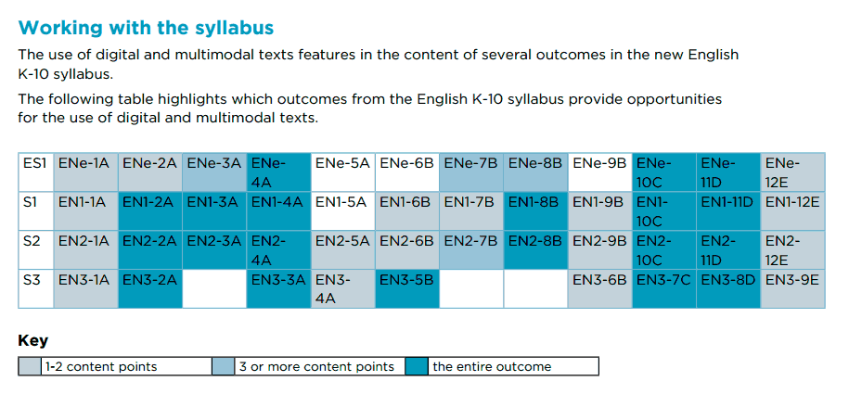
Writing and representing
Expressing themselves
Reading & Viewing
Reading & Viewing
Thinking imaginatively, creatively and interpretively
Handwriting & Digital technologies
Writing and representing

Slide 4
How can I make multimodal and digital texts?

Slide 5
Create Comics!
Strip Designer $2.99
English – writing, Grammar/Punctuation, vocab Activities.
Maths - Shape Stories, Angle hunts, number hunts.
PD/Health – values programs, role playing.
Science – detailing experiments, explanations
Hsie – fact files, event recreations.
CAPA – showcasing artwork.

Slide 6
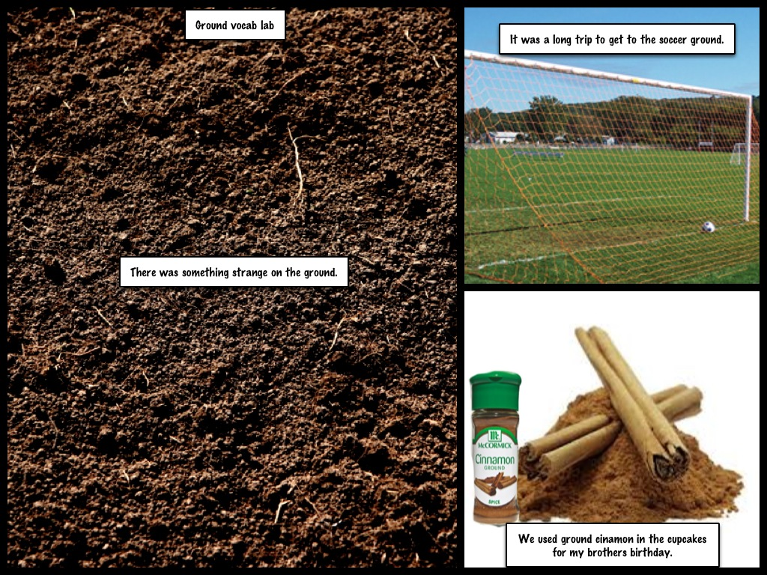
VOCAB LAB
Select a word and use it in three different ways

Slide 7
VOCAB LAB
Etymological word study

Slide 8
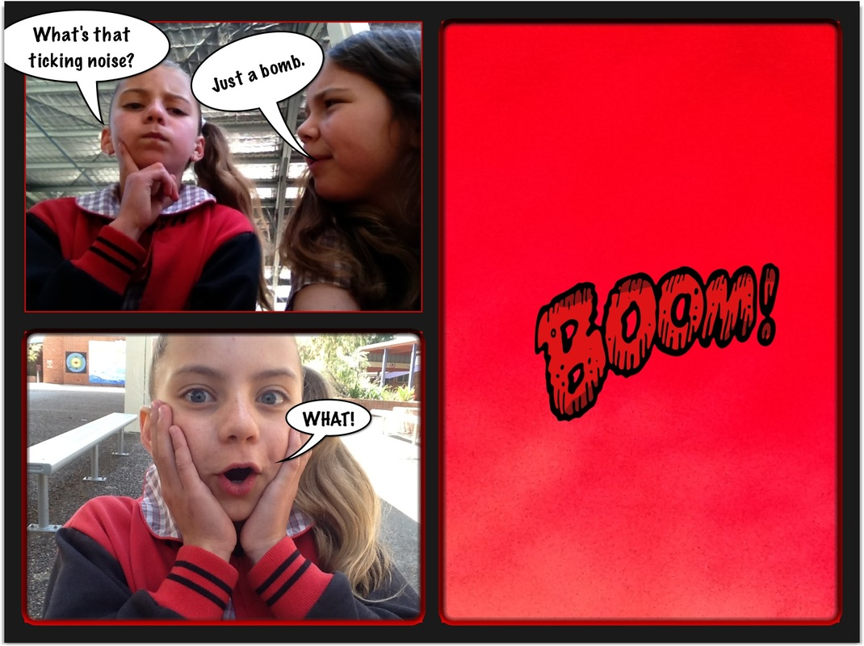
Onomatopoeia
Stage 2-3
Create a short scene using onomatopoeia

Slide 9
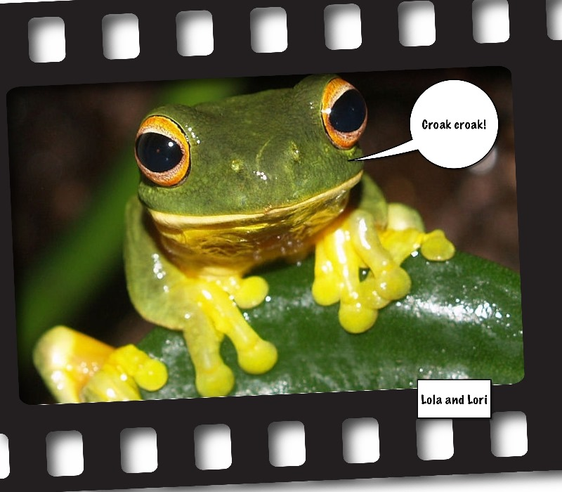
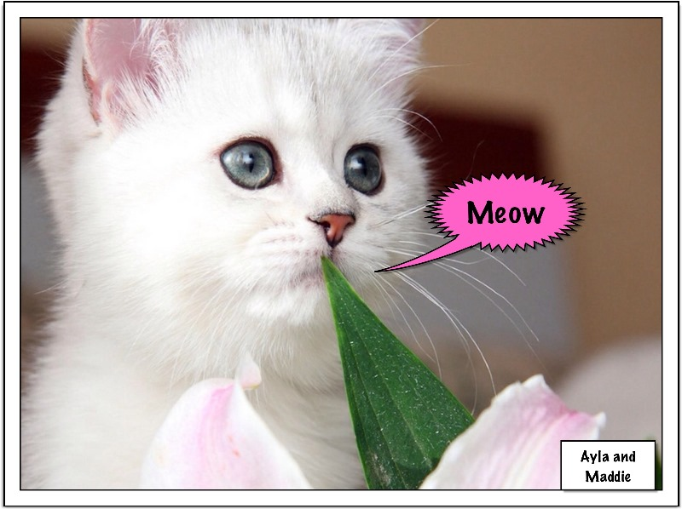
Onomatopoeia
Stage 1
Create a class book of animal sound words

Slide 10
Maths
Differentiated tasks
Shape hunt
Find 3D shapes around the school and label them

Slide 11
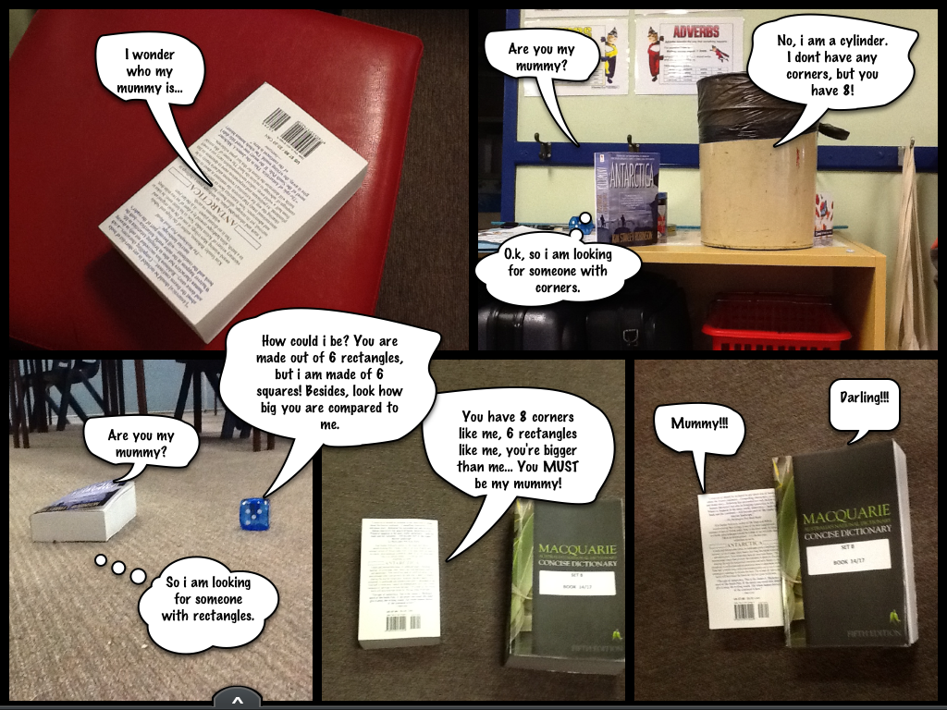
Shape Story
Demonstrate your knowledge of 3D shapes.

Slide 12
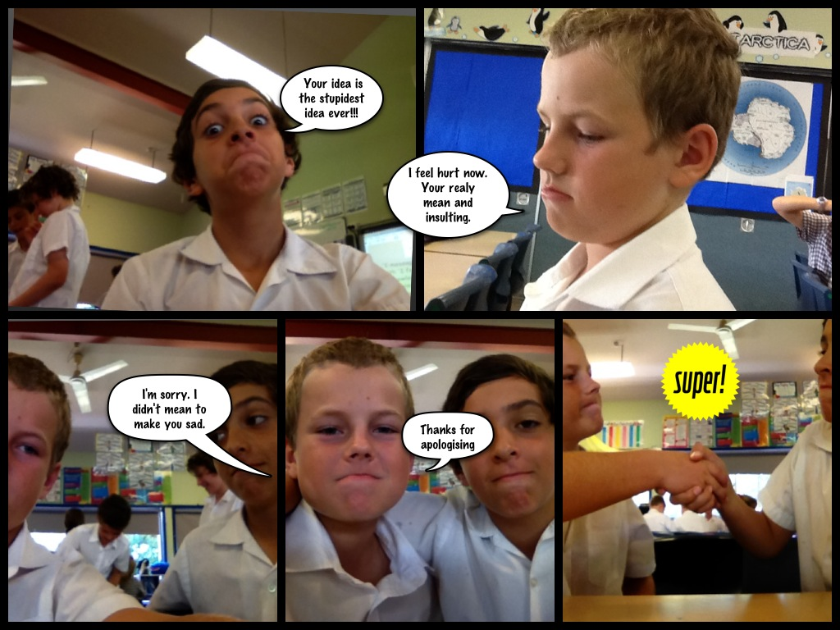
PD/Health
Role play an example of using an iMessage

Slide 13
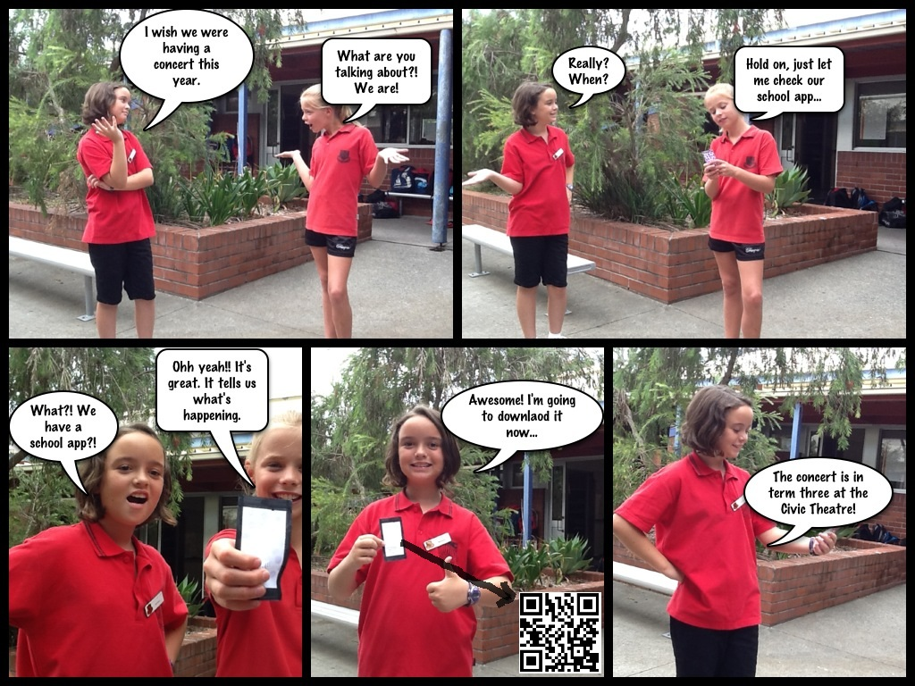
Advertising!
Insert QR codes into your comics to link your readers with more info – or in this case the school app

Slide 14
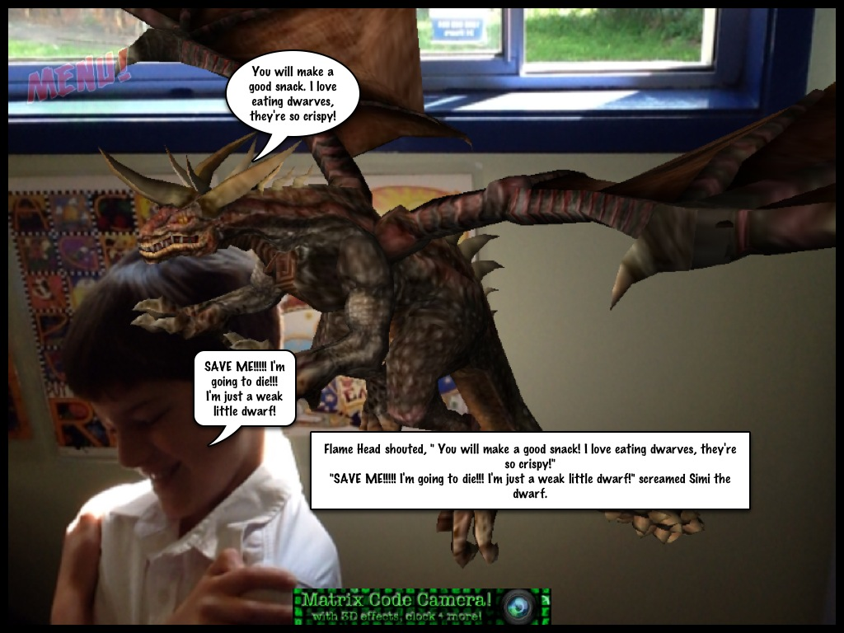
Punctuation
Using Speech marks
Combined with Dragon detector

Slide 15
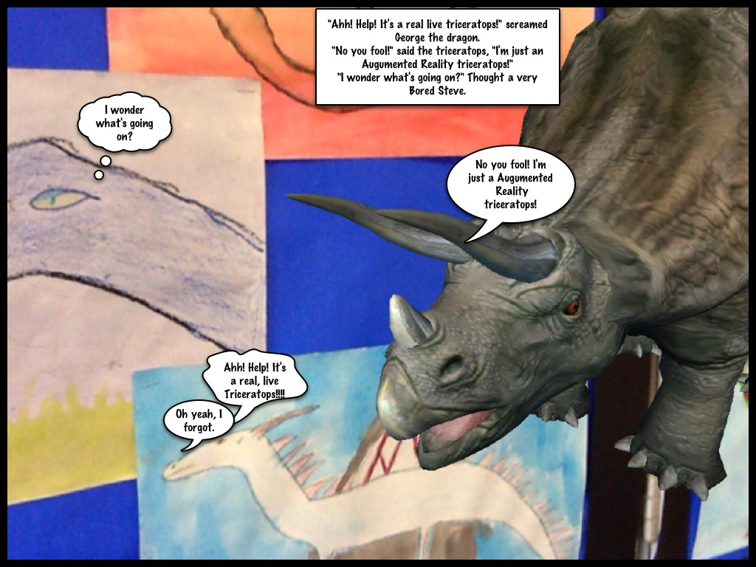
Punctuation
Using Speech marks

Slide 16
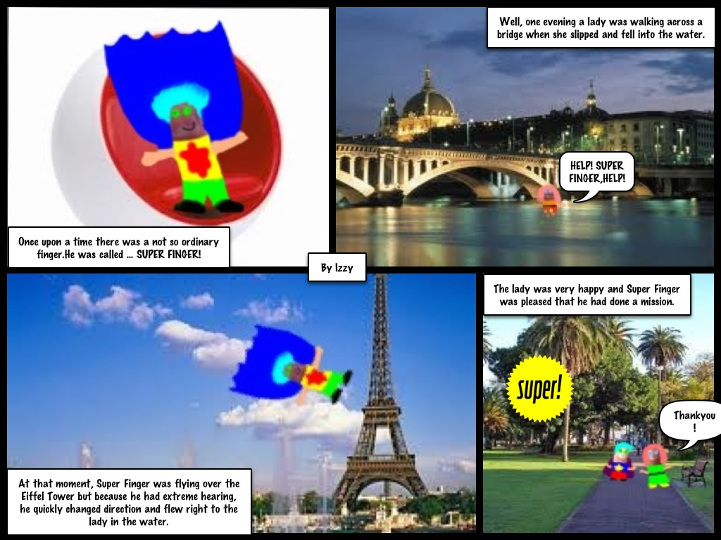
Text innovation
After reading superfinger in 13th story treehouse create your own superfinger comic

Slide 17
Tellagami or buddy poke
What could they be used for?
Tellagami
FREE (IAP)
Persuasive arguments
Advertisements
Summaries
Reviews
News or weather report
Explain a concept
Describe something

Slide 18
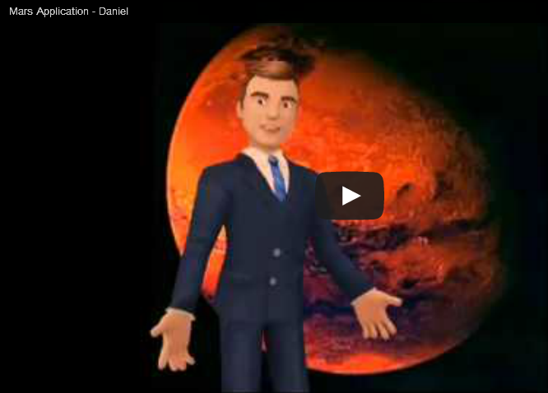
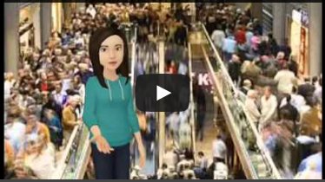
Persuasive arguments
Narrative Introductions

Slide 19
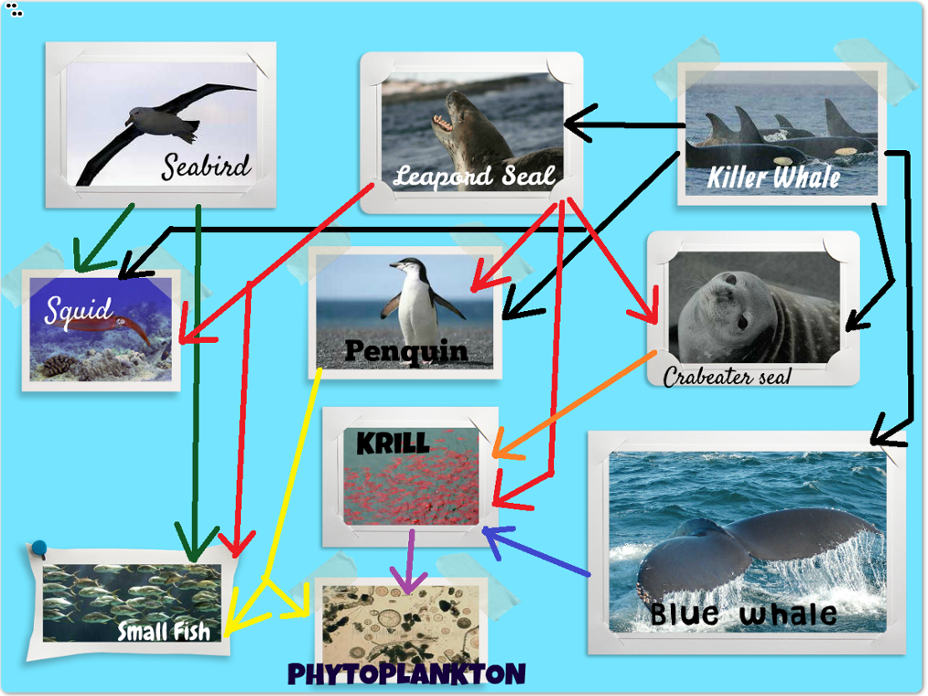
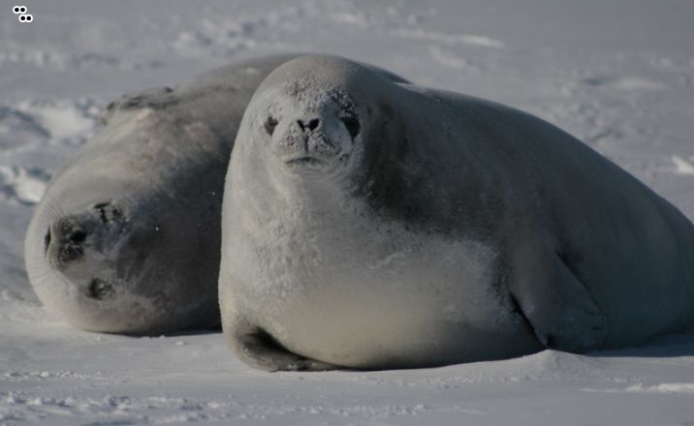
Thinglink
(App & website)
create interactive images that
Link to text, images, urls, videos, anything!
How Have My students used it?
Food Webs
Resource Hubs
Predictions
Maps

Slide 20
Path On
A fabulous app to accompany any lessons on typography.
Arrange text on an image to capture audience attention, provoke emotion and make distinctions between sets of text.

Slide 21
ChatterPIX kids
Yakit Kids
Make 2D and 3D shapes describe their properties.
Make animals give facts about themselves.
Introduce a character form a story.
Make your own drawings talk!

Slide 22
Steve Parish Postcards
Bill Atkinson Photo Cards
Both
free!

Slide 23
HAIKU DECK
Slick presentations that easily embed on your websites.
Activity ideas…
Word study
Glossary
Narrative summary.

Slide 24
Photo mapo
Accompany a recount of an excursion.
Diary entry.
Persuasive poster.
HSIE projects – location and images from famous landmarks, historical events.
Collaborative project – share where each of the participants is located.

Slide 25
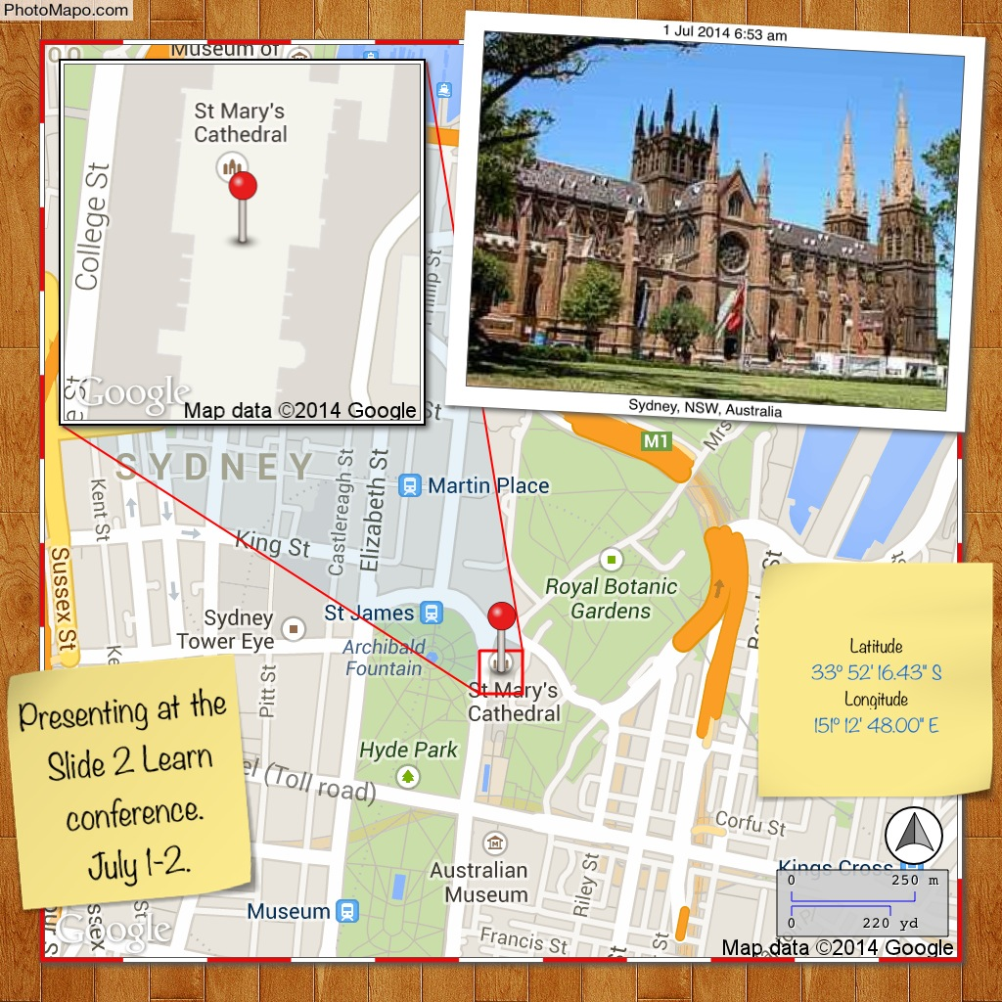

Slide 27
DIY suite
By Innovative net

Slide 28
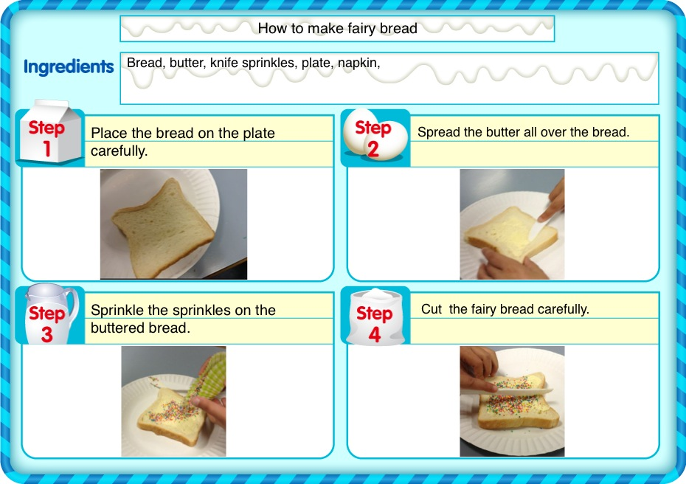

Slide 29
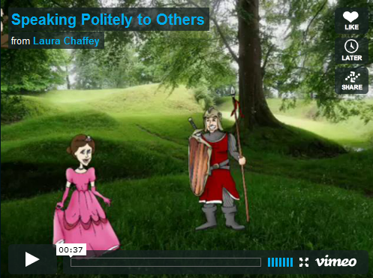
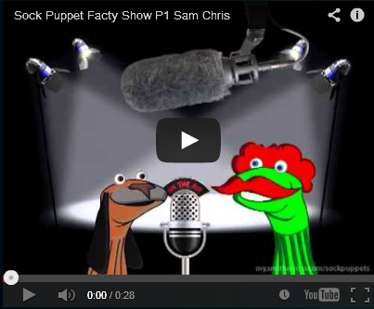
Puppet Pals
Sock Puppets

Slide 30
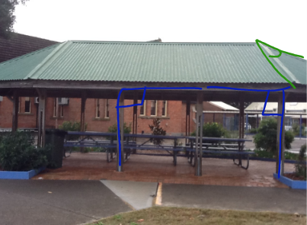
Educreations (Free)
Explain Everything ($2.99)

Slide 31
Creative book Builder
Book Creator
My Story Maker

